Slide 1


Saroj Lamichhane

Slide 2
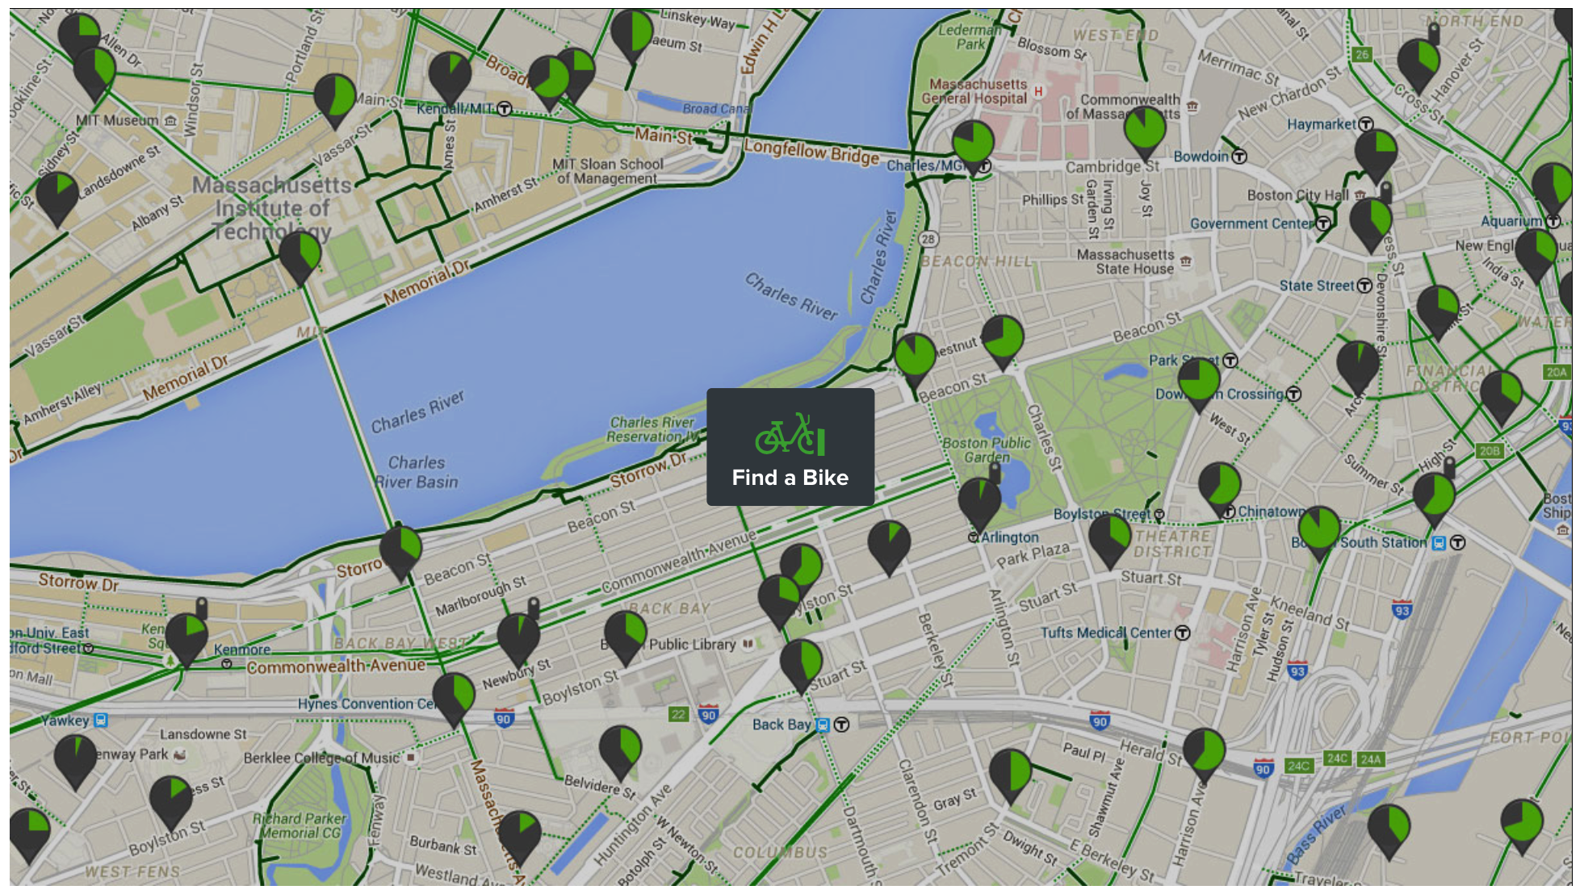

Slide 3
About Data
Data source:
https://s3.amazonaws.com/hubway-data/index.html
Chose March 2018 dataset for analysis.
Data size
Columns: 15
Rows: 62,985 (one for every trip)
Daily Boston temperature data:
https://www.usclimatedata.com/climate/boston/massachusetts/united-states/usma0046/2018/3

Slide 4
Data Includes:
Trip Duration (seconds)
Start Time and Date
Stop Time and Date
Start Station Name & ID
End Station Name & ID
Bike ID
User Type (Casual = 24-Hour or 72-Hour Pass user; Member = Annual or Monthly Member)
Birth Year
Gender, self-reported by member

Slide 5
How was bike use in various bike stations?
164+ bike stations across Boston Area

Slide 6
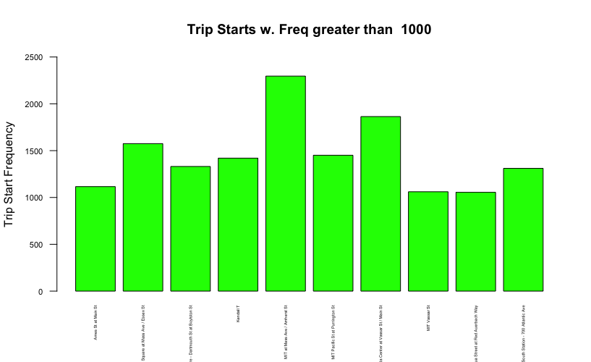
Bike Stations w. Trip Frequency greater than 1000

Slide 7
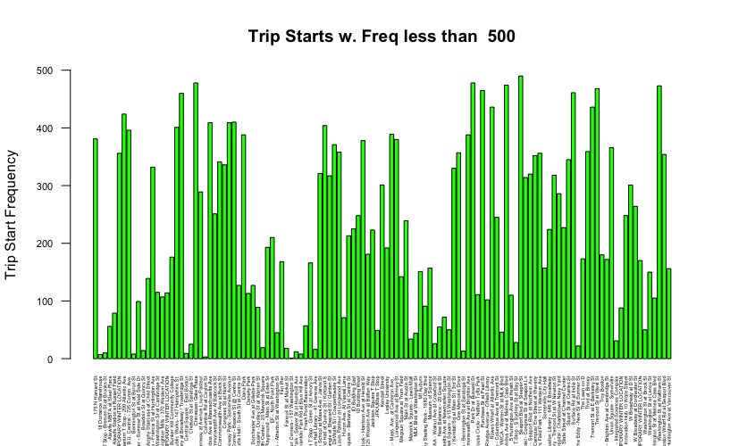
Bike Stations w. Trip Frequency less than 500

Slide 8
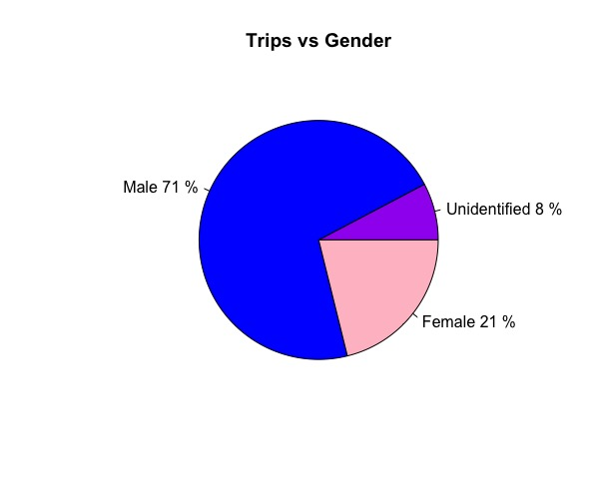
Trip takers Gender distribution

Slide 9
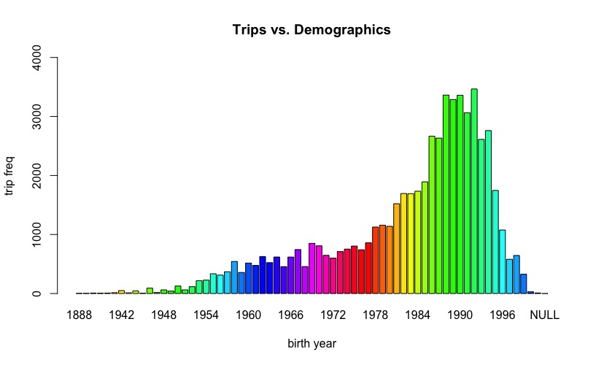
Trip Demographics

Slide 10
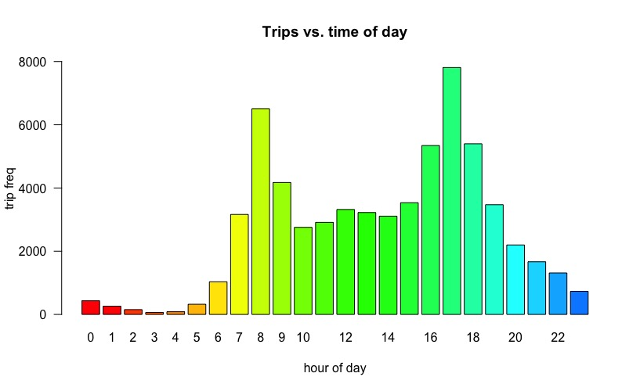
Trip vs Time of day

Slide 11
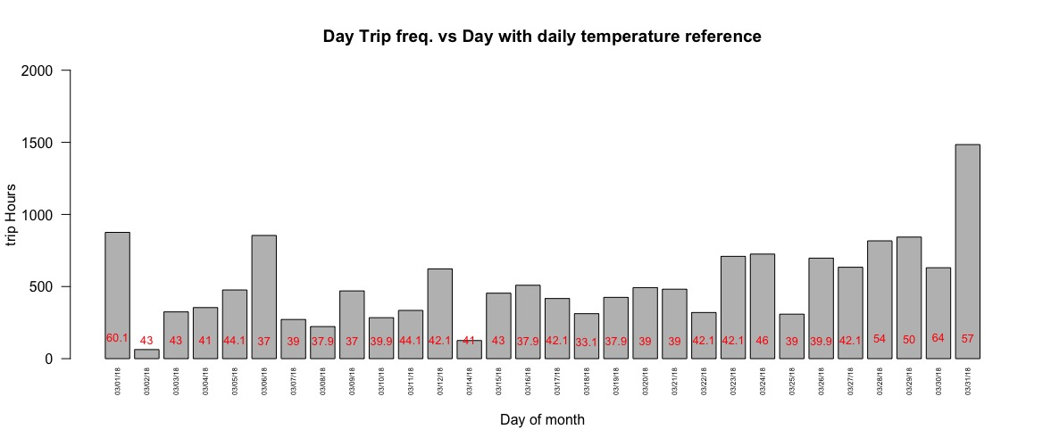
Trip frequency vs Day of month(with Temp. legend)

Slide 12
Summary of Trip Duration (in minutes)
For the entire data set
Min. 1st Qu. Median Mean 3rd Qu. Max.
1.017 5.883 9.483 14.803 15.633 11117.833
For stations with more than 1000 trips
Min. 1st Qu. Median Mean 3rd Qu. Max.
1.033 5.233 7.817 11.343 12.754 7117.517
For stations with less than 500 trips
Min. 1st Qu. Median Mean 3rd Qu. Max.
1.017 6.183 10.183 16.711 17.167 8564.183

Slide 13
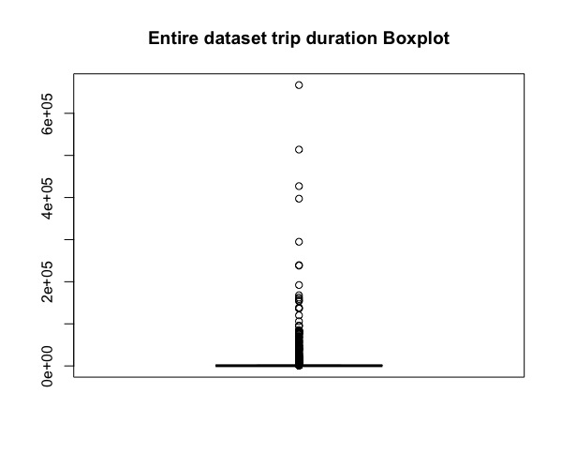
Trip Duration(minutes) Boxplot- entire dataset

Slide 14
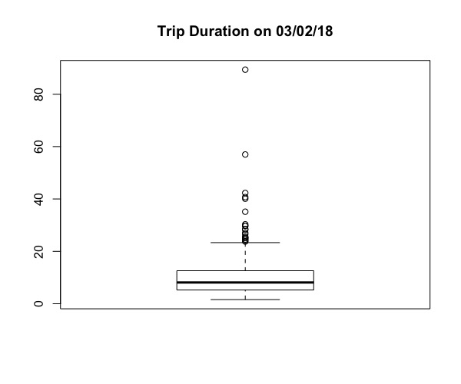
Trip Duration(minutes) Boxplot on 03/02/18

Slide 15
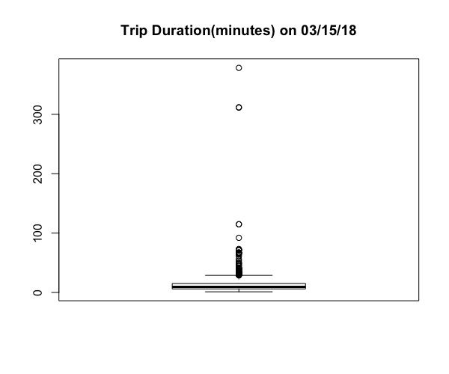
Trip Duration(minutes) Boxplot on 03/15/18

Slide 16
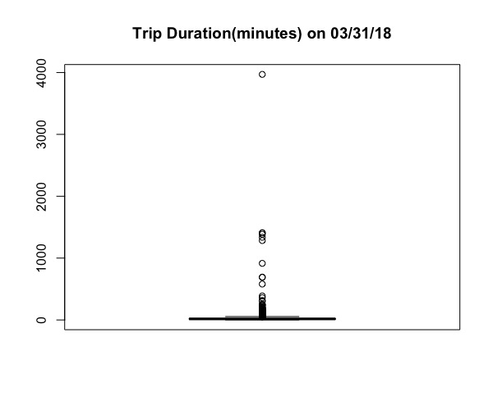
Trip Duration(minutes) Boxplot on 03/31/18

Slide 17
Various sampling methods tested
Simple random sampling with replacement(n=70)
Simple random sampling without replacement(n=70)
Systematic sampling (n=100)
Stratified Sampling(using Gender strata, srswor)
Cluster Sampling (using Gender, n=2, srswor)

Slide 18
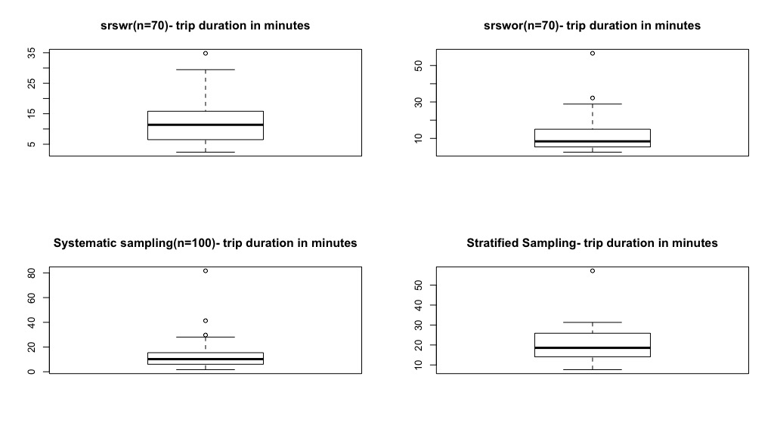
Sampling Methods(boxplot of Trip Duration in minutes)

Slide 19
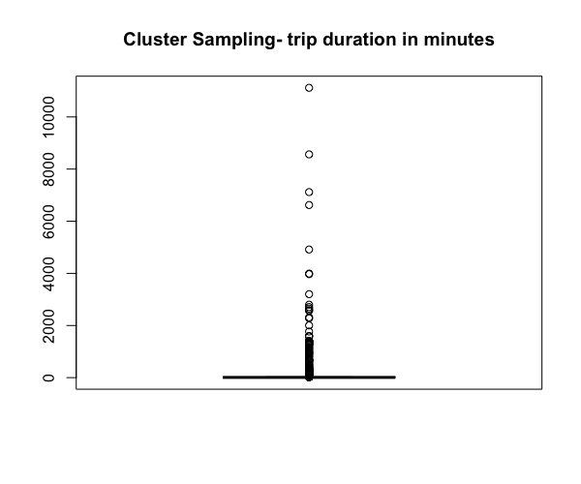
Cluster Sampling (boxplot of Trip Duration in minutes)

Slide 20
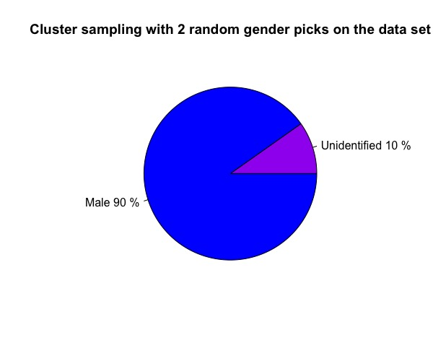
Cluster Sample (gender distribution)

Slide 21
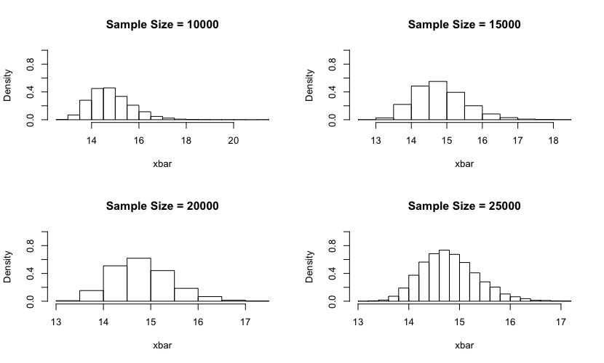
Central Limit Theorem
Sample Size = 10000 Mean = 14.81386 SD = 0.8772625
Sample Size = 15000 Mean = 14.80289 SD = 0.7184994
Sample Size = 20000 Mean = 14.81078 SD = 0.6225392
Sample Size = 25000 Mean = 14.80571 SD = 0.5570686

Slide 22
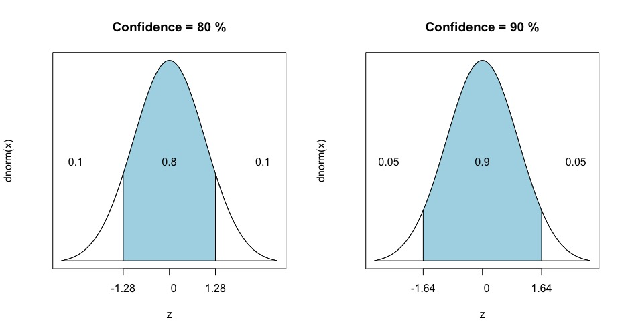
Confidence interval curve
80% Conf Level (alpha = 0.20), CI = 618.12 - 1046.29 , z: -1.28 , 1.28
90% Conf Level (alpha = 0.10), CI = 557.43 - 1106.98 , z: -1.64 , 1.64

Slide 23
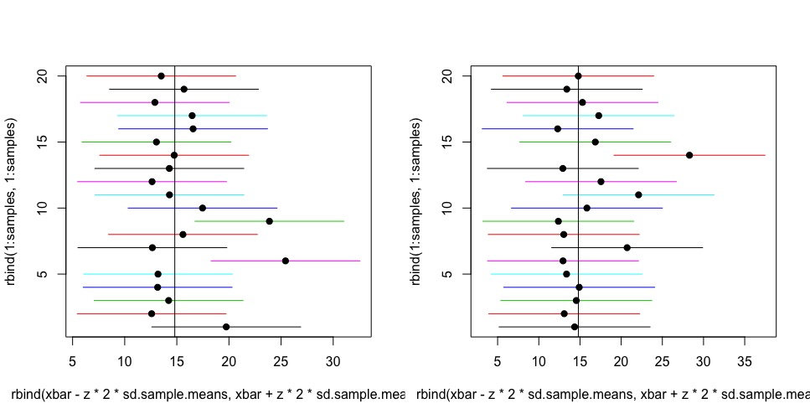
1000 data samples mean(in minutes) repeated 20 times -for 80% and 90% confidence intervals

Slide 24


